Slide 1


MINI
ISMA UNIVERSITY
PROJECT
AN ALARM CLOCK
SAIDKOSHIFKHON SOLIEV

Slide 2

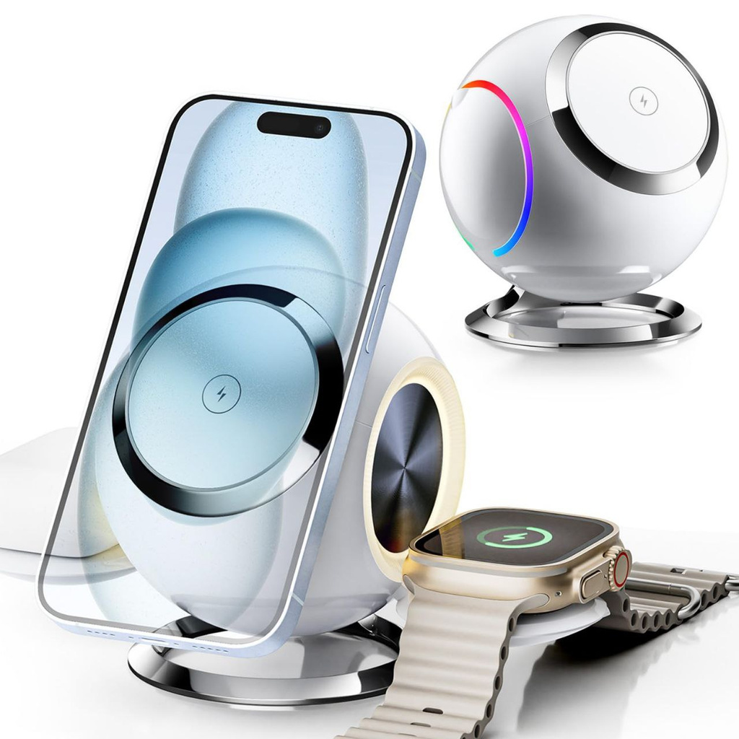


Project Name: Parental Alarm
Project Name: Parental Accountability Alarm (PAA)
Objective:
To create an alarm system where users place their phone in a designated spot by a certain time every night. If they fail to do so, the system sends an alert message to their parents or guardians, promoting accountability and better sleep habits.
Key Features:
  Alarm Activation: Users must place their phone in the designated spot by a specific time.
  Phone Detection: The system detects whether the phone is placed in time, using Bluetooth, Wi-Fi, or a docking station sensor.
  Alert Mechanism: If the phone isn't placed in time, the system sends a pre-configured message to the parents.
  It also charges the phone.

Slide 3




GOALS AND OBJECTIVES
Project Strategy & Plan:
Core Business Processes:
Organizational Structure:
  Prototype Development: 2 months
  App Integration (if using an app): 3 months
  Testing and Feedback: 1 month
  Final Product Launch: 6 months
  User Registration & Configuration:
  Allow users to register and configure the alarm timing, message content, and parental contact details.
  Phone Detection Process:
  System detects whether the phone is in place using a sensor or docking station.
  Notification & Alert Process:
  If the phone isn't placed in time, the system automatically triggers a message to the parents.
  Data Tracking & Analytics:
  Track users' adherence to the alarm and provide insights into how often they miss placing their phone.
  Customer Support Process:
  Support users with technical issues, feedback, and troubleshooting.
  Project Manager: Oversees the project timeline, ensures milestones are met, and manages team communication.
  Software Engineers: Responsible for developing the phone detection system and notification features.
  UI/UX Designers: Design the user interface for the alarm system and any companion app, ensuring ease of use.
  Data Analyst: Analyzes user data, adherence to alarm, and feedback to improve the system.
  Customer Support Team: Handles user queries, technical support, and feedback post-launch.
  Marketing Team: Responsible for promoting the alarm system, engaging potential customers, and building brand awareness.

Slide 4

RISKS IN PANDEMIC TIME:
1. Risk: Supply Chain Problems
You might have trouble getting hardware parts like sensors or docking stations due to shipping delays or factory closures.
Solution:
  Use Multiple Suppliers: To get parts from different suppliers to avoid relying on just one.
  Switch to Software: To focus on a mobile app that detects the phone without needing extra hardware.
2. Risk: Lower Consumer Spending
People might spend less money on non-essential products during the pandemic.
Solution:
  Flexible Pricing: To offer cheaper payment plans or free trials to make the product more affordable.
  Promote Benefits: To show how the alarm helps parents manage kids' routines, especially with increased screen time at home.
  Discounts: Offer special promotions or discounts to attract more customers.
3. Risk: Remote Work Challenges
The team might face difficulties working remotely, slowing down progress due to less communication and collaboration.
Solution:
  Use Online Tools: Adopt tools like Slack or Zoom to stay in touch and keep the project on track.
  Allow Flexible Hours: Let team work at times that fit their home lives.
  Frequent Check-ins: Holding regular virtual meetings to discuss progress and solve any problems quickly.

Slide 5

WHY THE WATERFALL MODEL?
01
02
03
04
CLEAR STRUCTURE AND ORGANIZATION
EASIER TO TRACK PROGRESS
REDUCES RISK OF OVERLAPS AND ERRORS
FOCUSED TESTING AND QUALITY CONTROL
The waterfall model allows us to follow a structured, step-by-step process. This is ideal for our alarm clock project, as it ensures each feature is carefully planned and fully completed before moving to the next stage.
With defined phases—Requirements, Design, Implementation, Verification, and Maintenance—it’s easy to track our progress and make sure we’re meeting project goals at each stage.
Since each phase is completed before moving on, it minimizes the risk of issues later. For example, designing the interface first means we can avoid coding mistakes related to layout or functionality conflicts.
The verification phase gives us dedicated time to test each function, which is critical for a project like an alarm clock.

Slide 6
CLOUD TECHNOLOGY
01
02
03
04
05
DATA STORAGE & BACKUP
REMOTE ACCESS
IOT INTEGRATION
SECURITY
SCALABILITY
Securely saves alarm settings, ensuring no data loss if devices are reset.
Allows users to set and adjust alarms from any device, enhancing convenience.
Syncs with smart home devices (e.g., lights, coffee maker) for a seamless wake-up experience.
Encrypts data to protect user privacy
Easily expands to support more users and features without extra hardware.
PLUS: REAL-TIME UPDATES, INSTANTLY DEPLOYS UPDATES AND NEW FEATURES, KEEPING THE PRODUCT CURRENT.

Slide 7

QUALITY MANAGEMENT ROLE FOR ALARM CLOCK PROJECT
Role Purpose: Ensure the alarm clock meets high standards of reliability, usability, and performance to enhance user satisfaction.
Key Responsibilities:
  Quality Assurance (QA): Oversee testing processes to confirm alarm accuracy, app responsiveness, and interface usability.
  Quality Control (QC): Conduct performance checks, gather user feedback, and refine features to prevent and address issues.
  Continuous Improvement: Implement feedback mechanisms and regularly update features to maintain and exceed quality standards.
Goals:
  Reliability: Ensure >99% alarm accuracy.
  User Satisfaction: Achieve a user rating of 4.5/5.
  Error Minimization: Keep system error rate below 1%.

Slide 8

THANK'S FOR WATCHING

